Slide 1
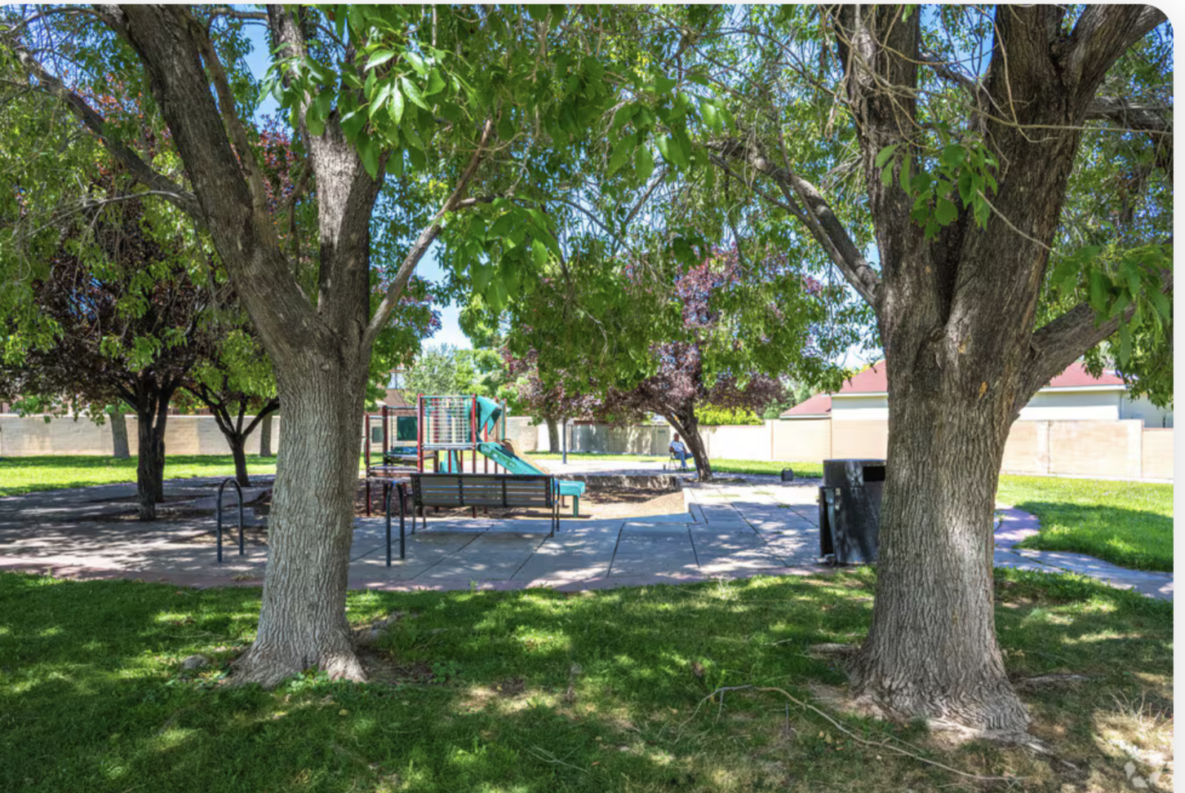
Estimating the Economic, Fiscal, and Social Impacts of Fairgrounds Redevelopment
Kelly O’Donnell PhD
Kelly@odonnelleconomics.com
August 21, 2025

Slide 2
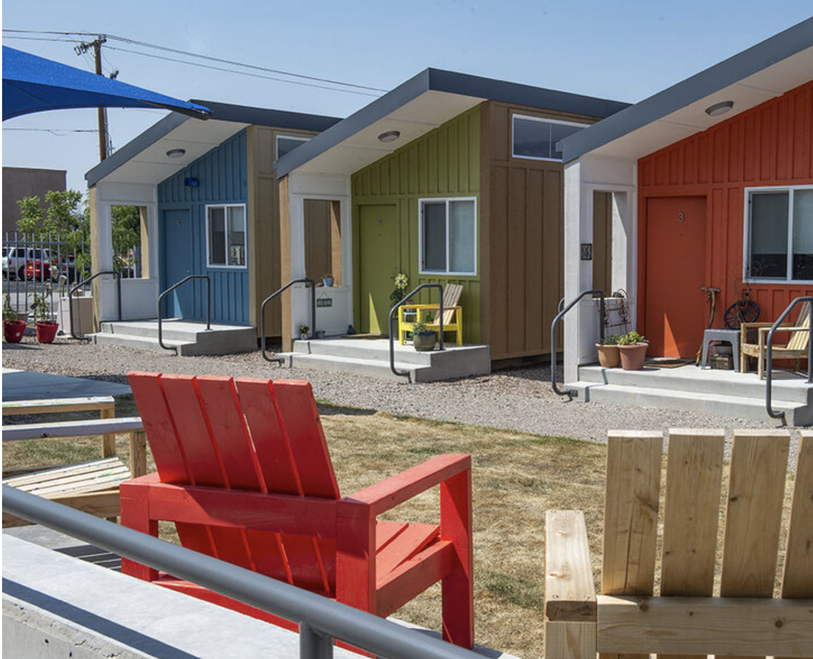
Overview
Economist’s Role
Preliminary Findings from
Regional Analysis
Next Steps

Slide 3
Three Distinct But Interrelated Impacts
Economic impact
Jobs
Income
Long term v. Short term
Fiscal impact
Tax Revenue
Bonding Capacity
Social impact
Housing
Public Safety
Access to Services
Displacement

Slide 4
Development Tradeoffs
Housing
High social impact
Stadium
Retail
Moderate social impact
Low social impact
High long term fiscal impact
unknown LT fiscal impact
Unknown LT economic impact
Moderate economic impact
Low (long term) fiscal impact
Low (long term) economic impact

Slide 5
Many Objectives with Limited Space
New Mexico State Fairgrounds Current Land Use
Use | Acres
Adjacent property (to be purchased) | 12
State Fair | 103
Track and horse facilities | 106
Historic buildings | 16
Casino | 13
Total | 250

Slide 6
Preliminary Economic Analysis: 3 Scenarios
The State Fair moves but the track and accompanying horse facilities remain at the site
01
The State Fair, track, and horse facilities all move
02
The State Fair stays and the track and horse facilities move
03

Slide 7
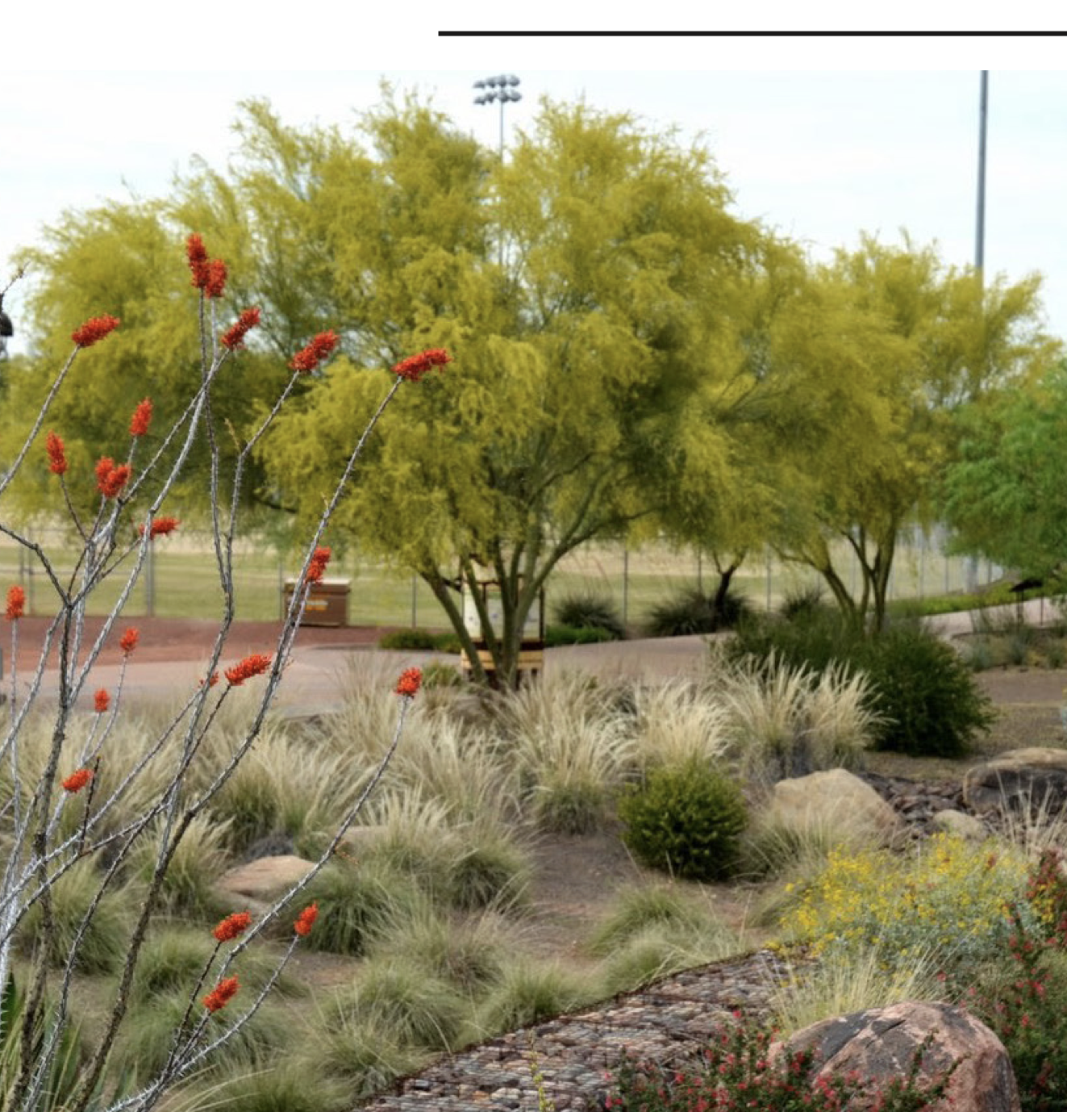
Preliminary Economic Analysis
Assumes housing and commercial development with ample common areas and green space.
Regional economic impacts from:
  Construction – big but temporary
  Tenant businesses – modest but long term
  New resident spending
Redevelopment would support up to over 10k new (temporary and permanent) jobs
Spillover benefits to surrounding community

Slide 8
Next step: Local Impacts
Source: U.S. Census Bureau, OnTheMap Application and Longitudinal Employer-Household Dynamics (LEHD) Origin-Destination Employment Statistics

Slide 9
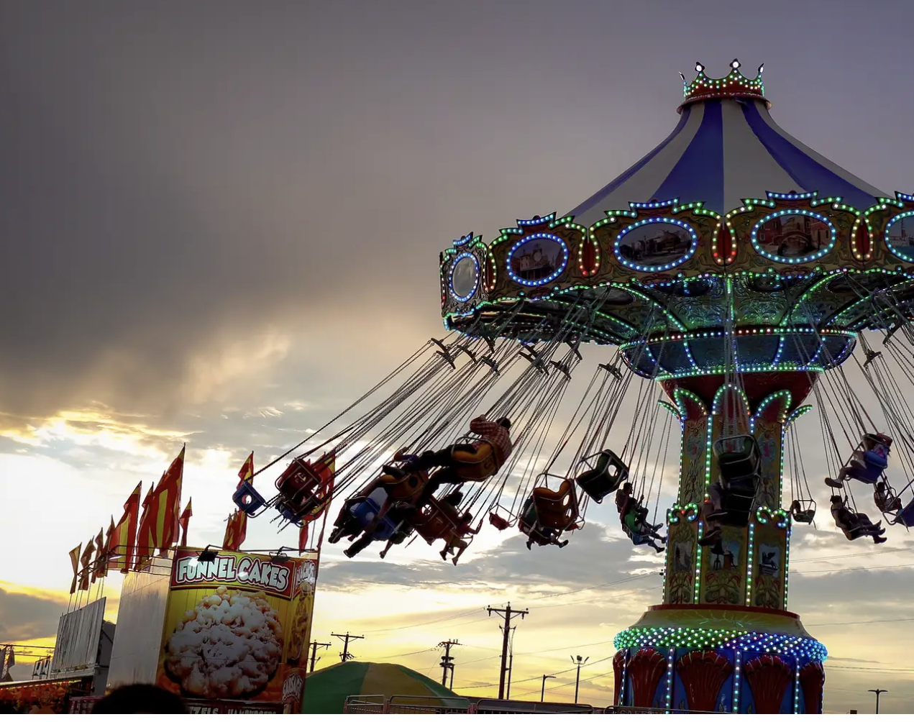
Questions?

