Slide 1

NmExpo Area Stats July 2025
July 16, 2025

Slide 2
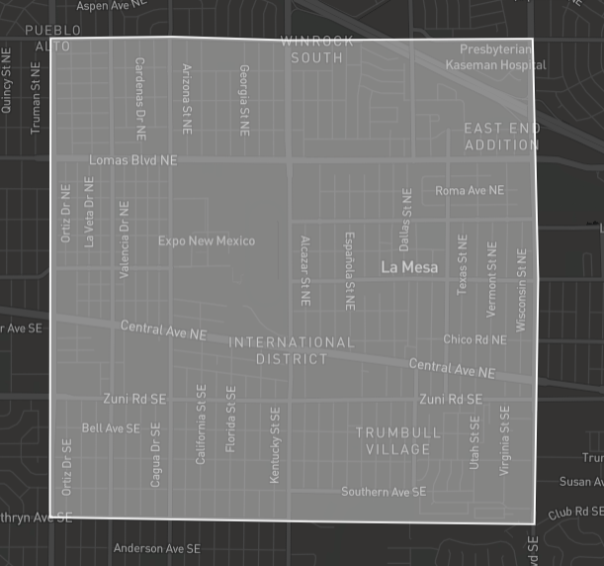
Area
The area for this report is bounded by;
Constitution Ave to the North
Kathryn Ave to the South
San Mateo Blvd the West
Wyoming Blvd to the East

Slide 3
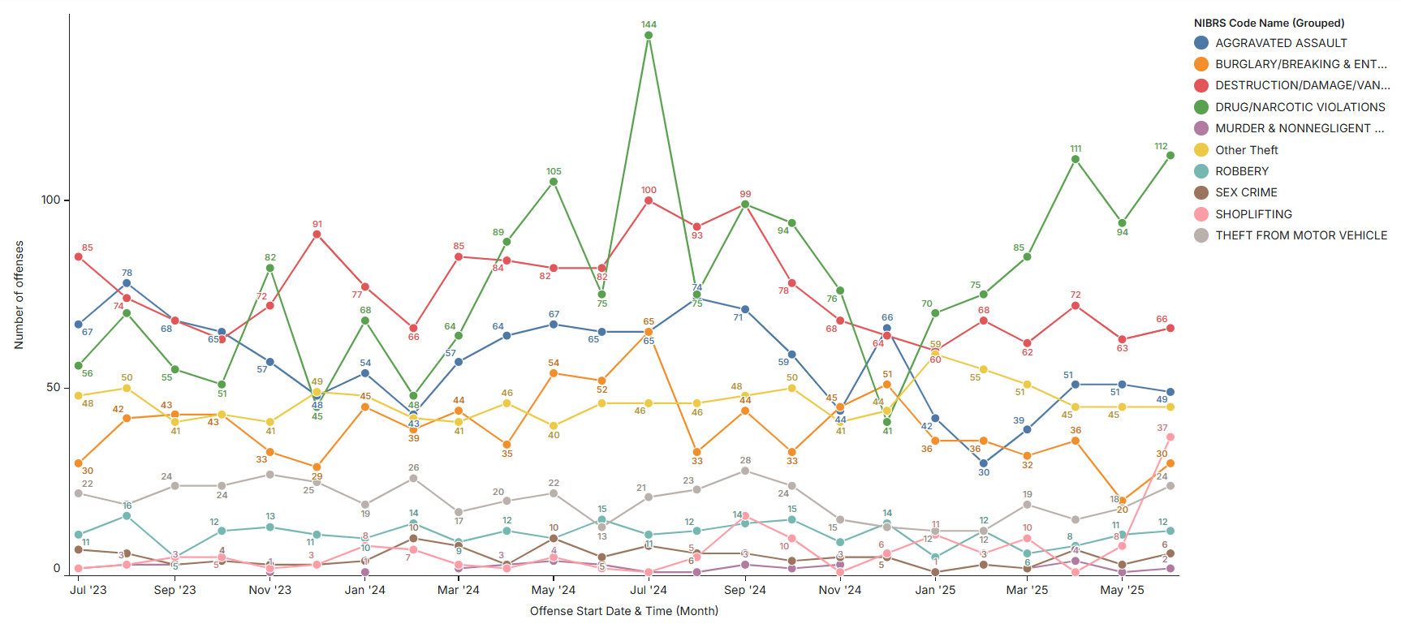
offenses of interest per Month (Last 24 months)

Slide 4
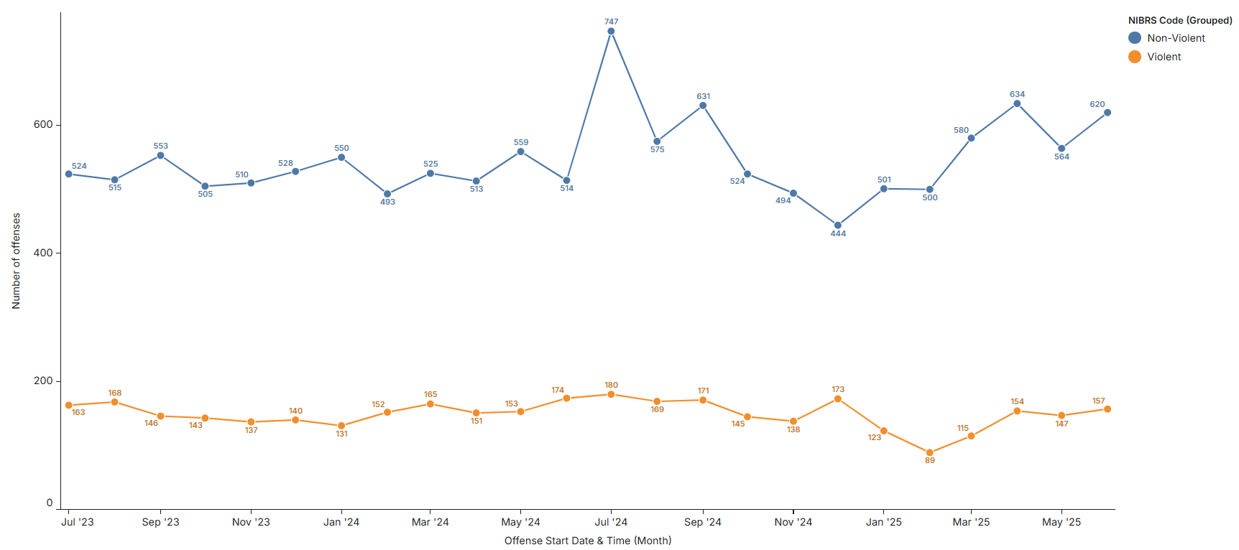
Violent and Non-Violent offenses per Month (Last 24 months)

Slide 5
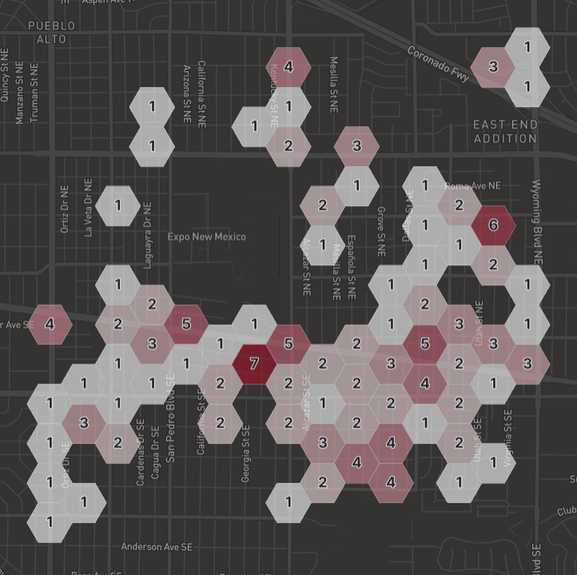
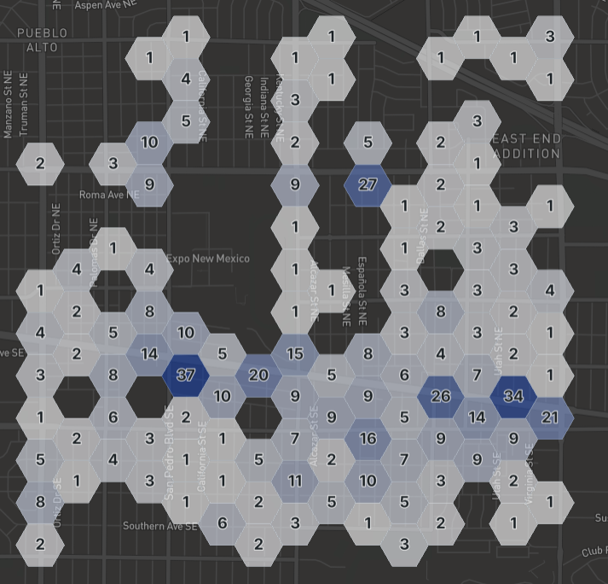
Offenses last Month
Violent
Non-Violent

Slide 6
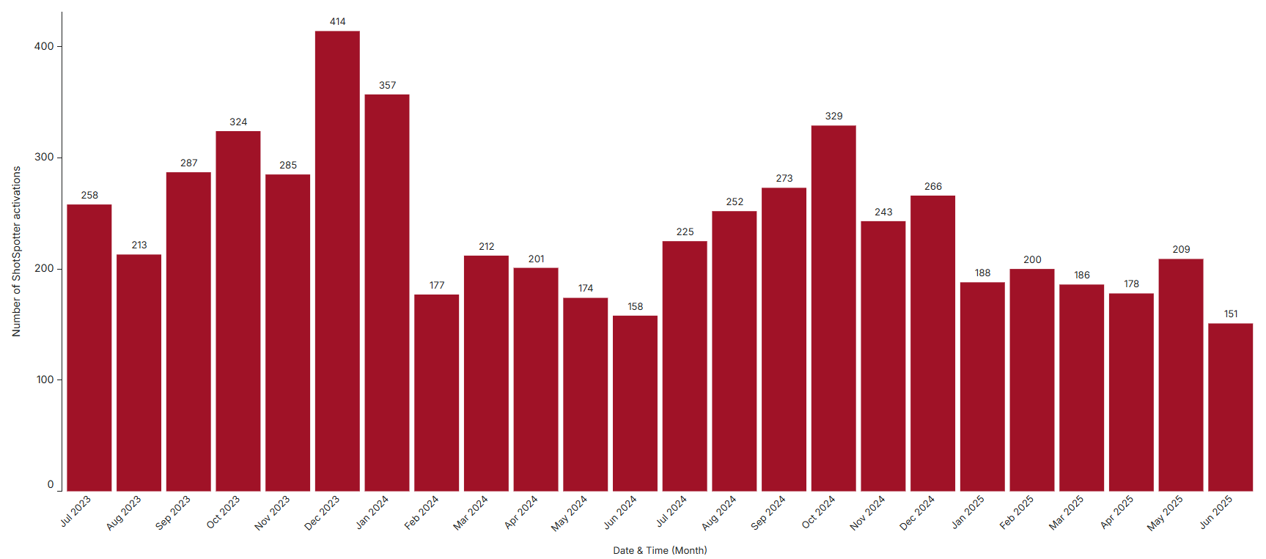
ShotSpotter activations per Month (Last 24 months)

Slide 7
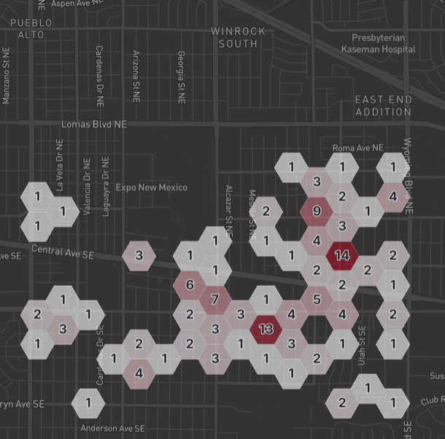
ShotSpotter activations last Month

Slide 8
Disclaimers
APD Internal use only
Produced by Crime Analysis Unit
Subject to change on further analysis
Based on Offense and ShotSpotter data pulled from Peregrine on 7/16/2025 @1300
  Violent Category includes NIBRs codes: 09(A-B), 11(A-D), 13(A-C), 36(A-C), 64A, 100, 120, 200, and 720

